Slide 1
DUBLIN CITY UNIVERSITY · SCHOOL OF COMPUTING
Dual-Stream Vision Transformer for
Multi-Domain Skin Disease Classification
Using a frozen DINOv2 backbone · 14 classes · 3 medical domains
Sai Sawanth Kanjarla · Amer Ahmed Mohammed
Supervisor: Dr Luca Rossetto
Notes:
15 min total. ~30 s here. One line: a single model that screens skin images across cancer, benign and infectious disease at once, training under 1% of the parameters.

Slide 2
RESEARCH GAP
Every ingredient exists — nobody has combined them
Prior work | Onco | Benign | Infect. | One unified model | Imbalance-aware training | Reported
Mohan et al. [2] — DINOv2, 31 cls | ✓ | ✓ | ✗ | ✓ | ✗ | 96.48%
Alghoraibi et al. [13] — ViT, 6 cls | ✗ | ✗ | ✓ | ✓ | ✗ | 92%
Badr et al. [10] — hierarchical CNNs, 40 cls | ✓ | ✓ | ✗ | ✗ | ✗ | 90–94%
Cai et al. [8] — BPaCo contrastive | ✓ | ✓ | ✗ | ✓ | ✓ | —
This work — dual-stream DINOv2, 14 cls | ✓ | ✓ | ✓ | ✓ | ✓ | 81.65%
1
No cross-domain model
2
Domain routing unexplored
3
Imbalance handled in isolation
Not one published study classifies oncological, benign and infectious skin conditions inside a single network.
Hierarchical work uses separate CNNs per domain; routing has never been made learnable and end-to-end.
Contrastive and focal remedies are validated on single-domain lesion sets, never under a merged-source shift.
Dual-Stream DINOv2 · DCU School of Computing
3
Notes:
~1 min. Read the last column: high accuracies, but each inside one narrow domain. Our number is lower because the task is strictly harder — three domains at once.

Slide 3
DATASET
36,656 images · 14 classes · 3 domains · 2 merged sources
Class | Domain | Stream | Train | Test
Melanocytic nevi | Benign | 1 | 10,300 | 1,288
Melanoma | Oncological | 1 | 3,617 | 453
Monkeypox | Infectious | 2 | 3,408 | 426
Basal cell carcinoma | Oncological | 1 | 2,658 | 333
Benign keratosis | Benign | 1 | 2,099 | 263
HFMD | Infectious | 2 | 1,932 | 242
Healthy | Infectious | 2 | 1,368 | 171
Chickenpox | Infectious | 2 | 900 | 113
Cowpox | Infectious | 2 | 792 | 99
Actinic keratoses | Oncological | 1 | 693 | 88
Measles | Infectious | 2 | 660 | 83
Squamous cell carc. | Oncological | 1 | 502 | 64
Vascular lesions | Benign | 1 | 202 | 26
Dermatofibroma | Benign | 1 | 191 | 25
Total |  |  | 29,322 | 3,674
36,656
14
3
images
classes
domains
80 / 10 / 10 split — 29,322 train · 3,660 val · 3,674 test
Imaging protocol shift
HAM10000
850 × 754 px, standardised dermoscopy
MSLDv2.0
274 × 274 px, variable clinical photos
Risk: the model could learn the camera, not the disease.
Benign 43.6%
Infectious 30.9%
Oncological 25.5%
Dual-Stream DINOv2 · DCU School of Computing
4
Notes:
~1.5 min. Two benchmark sets merged: HAM10000 dermoscopy plus MSLD v2.0 clinical photos. Flag the resolution gap — it is why style augmentation exists in the pipeline.

Slide 4
DATA PIPELINE
Three mechanisms against imbalance and source shift
1
Tiered augmentation
2
Style normalisation
3
Domain-balanced sampling
Augmentation strength scales inversely with class size — rare classes get more diverse views without duplicating majority data.
Colour jitter, Gaussian blur and noise on every tier (Albumentations) to erase source-specific appearance cues.
Sample weight = ½ · inverse class frequency + ½ · inverse domain frequency, so every batch sees all three domains.
Tiered augmentation strategy
Tier | Threshold | Classes | Ops
Aggressive | < 300 samples | 2 | 15
Moderate | 300 – 1,000 | 5 | 11
Light | > 1,000 | 7 | 8
All images resized to 224 × 224 and normalised with ImageNet statistics, matching DINOv2 pre-training.
Dual-Stream DINOv2 · DCU School of Computing
5
Notes:
~1.5 min. The three are complementary: augmentation fixes sample scarcity, style augmentation fixes the source shortcut, the sampler fixes batch composition.

Slide 5
BASELINE
Frozen DINOv2 + a single linear head
Input image
Frozen DINOv2-ViT-B/14
Single linear head
14-class prediction
3 × 224 × 224
86M params · all frozen
768-d CLS token
768 → 14
12,302 trainable (0.01%)
argmax over all classes
Loss
Pipeline
Purpose
Weighted cross-entropy only — no focal term, no contrastive term, no routing term.
Identical splits, augmentation and domain-balanced sampler as the proposed model.
Isolates what frozen DINOv2 features alone can do, so every later gain is attributable to architecture.
One head must separate 14 classes drawn from two completely different imaging modalities.
Dual-Stream DINOv2 · DCU School of Computing
6
Notes:
~45 s. The baseline is deliberately the strongest trivial option: same features, same data pipeline, only the head changes.

Slide 6
BASELINE RESULTS
It works on infections and collapses on everything else
63.20%
0.5944
0.6606
508
Stark domain asymmetry
Accuracy
Macro F1
Weighted F1
Cross-domain errors
Infectious classes reach 85.4% accuracy while oncological (53.4%) and benign (53.3%) sit near chance for their class counts.
Macro F1 exposes it
Domain macro F1 of 0.147 (benign) and 0.231 (oncological) against 0.517 for infectious — accuracy alone hides the failure.
Errors cross domain boundaries
508 test images are assigned to a class from the wrong medical domain — a mistake a domain-aware model should never make.
→ These three observations are exactly what the dual-stream design targets.
Dual-Stream DINOv2 · DCU School of Computing
7
Notes:
~1 min. This slide is the argument for the architecture — the failure is not uniform, it is domain-structured, so the fix should be structural too.

Slide 7
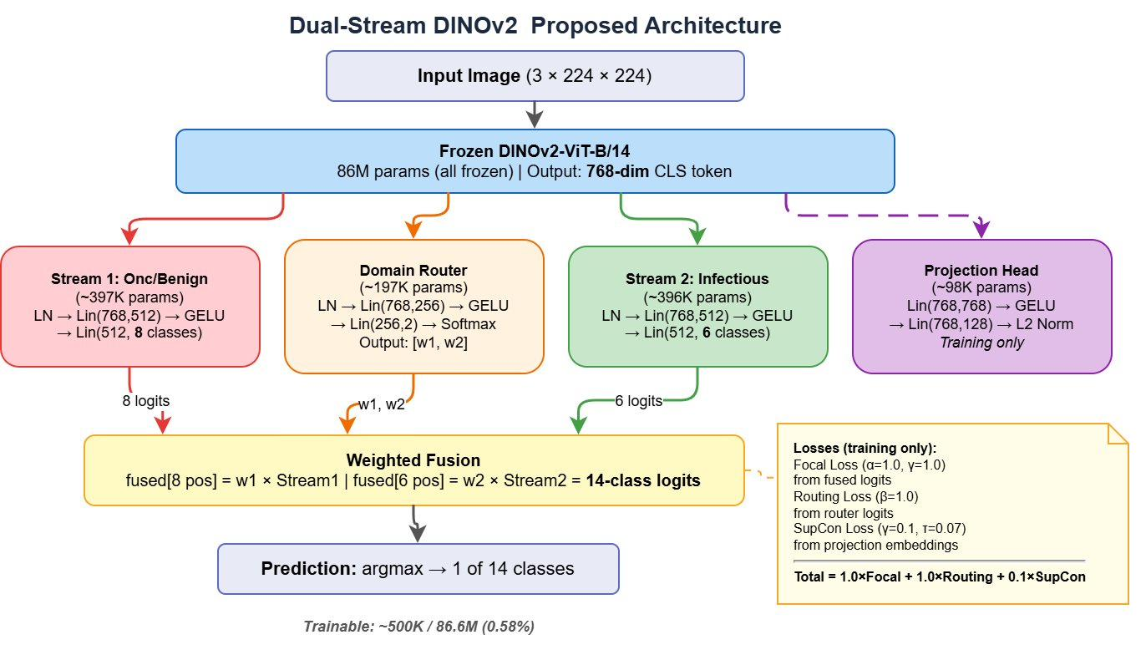
PROPOSED APPROACH
Dual-stream DINOv2 with a learnable domain router
Backbone stays frozen
0 of 86M parameters updated — no overfitting on 29K images, trains on one T4.
Learnable domain router
Soft weights w₁ + w₂ = 1 express uncertainty instead of a hard domain decision.
Two specialised streams
8 oncological/benign classes and 6 infectious classes get their own head.
Multi-task objective
1.0 · Focal (γ=1) + 1.0 · Routing CE + 0.1 · SupCon (τ=0.07).
≈500K trainable of 86.6M (0.58%)
Dual-Stream DINOv2 · DCU School of Computing
8
Notes:
~2.5 min — the core slide. Walk the diagram left to right, then land on the right-hand column: what makes this different is the router, not the backbone.

Slide 8
RESULTS
81.65% accuracy · 0.7236 macro F1 · 13 of 14 classes improved
Per-class F1 (Table VI)
Overall (Table V)
Class | Baseline | Proposed | Δ
Dermatofibroma | 0.154 | 0.143 | −0.011
Actinic keratoses | 0.314 | 0.397 | +0.083
Vascular lesions | 0.369 | 0.462 | +0.092
Squamous cell carc. | 0.286 | 0.481 | +0.195
Benign keratosis | 0.327 | 0.538 | +0.211
Melanoma | 0.518 | 0.642 | +0.124
Basal cell carcinoma | 0.498 | 0.741 | +0.244
Melanocytic nevi | 0.708 | 0.857 | +0.149
Chickenpox | 0.737 | 0.946 | +0.209
Monkeypox | 0.807 | 0.979 | +0.172
Measles | 0.929 | 0.982 | +0.053
Cowpox | 0.807 | 0.985 | +0.178
Healthy | 0.945 | 0.986 | +0.040
HFMD | 0.925 | 0.994 | +0.069
Model | Acc. | Macro F1 | W-F1 | Params
Baseline (linear) | 63.20% | 0.5944 | 0.6606 | 12K
Proposed | 81.65% | 0.7236 | 0.8098 | ≈500K
Δ | +18.45 pp | +0.1291 | +0.1492 | —
Domain level (Table VII)
Domain | BL Acc | PR Acc | BL F1 | PR F1
Oncological | 53.4% | 66.1% | 0.231 | 0.358
Benign | 53.3% | 79.2% | 0.147 | 0.269
Infectious | 85.4% | 98.1% | 0.517 | 0.979
Infectious solved Macro F1 0.9785 — all six classes above 0.94. Cowpox 0.985, monkeypox 0.979, chickenpox 0.946.
Melanoma ↔ nevi cut 59% The hardest clinical confusion falls from 226 to 93 misclassifications.
Cross-domain errors −28.3% 508 → 364. Routing accuracy 81.68% → 88.43%; zero infectious images misrouted.
McNemar test on paired predictions confirms the improvement is statistically significant.
Dual-Stream DINOv2 · DCU School of Computing
9
Notes:
~2.5 min. Do not read the per-class table aloud — point at the Δ column: 13 of 14 improved. Then the three callouts on the right, which are the story.

Slide 9
ABLATION STUDY
Every component contributes — routing contributes most
Variant | Acc. | Macro F1 | ΔF1
Baseline (linear) | 63.20% | 0.5944 | −0.1291
No domain routing | 79.67% | 0.7154 | −0.0082
Single-stream MLP | 80.16% | 0.7190 | −0.0046
No focal (CE instead) | 80.40% | 0.7192 | −0.0044
No contrastive loss | 79.78% | 0.7209 | −0.0027
Proposed (full) | 81.65% | 0.7236 | —
Routing is the load-bearing part
Removing learnable stream activation costs the most (−0.0082 F1) of any single component.
Gains come from design, not size
The single-stream MLP has the same ≈500K parameters and still loses — capacity is not the explanation.
Note the y-axis starts at 0.55 — the component gaps are small but consistent.
Destructive interference is real
v1 stacked sampling + focal class weights + contrastive: majority recall collapsed to 0.18.
Dual-Stream DINOv2 · DCU School of Computing
10
Notes:
~1.5 min. Anticipate the question that the deltas look small: answer with the single-stream MLP control — matched parameters, worse F1 — and that no ablation is redundant. The v1 fix was γ=1.0, no class weights, contrastive weight 0.1.

Slide 10
LIMITATIONS
What didn’t work, and honest limitations
Remaining challenges
v1 over-correction — fixed in v2
Class | F1 | Recall | Issue
Dermatofibroma | 0.14 | 0.08 | Only 191 training samples
Actinic keratoses | 0.40 | 0.28 | Confused with BCC (36%)
Vascular lesions | 0.46 | 0.35 | Only 202 training samples
Squamous cell carc. | 0.48 | 0.39 | Confused with BCC (27%)
Three corrections stacked at once
A balanced sampler, focal loss with class weights and a contrastive term all pushed against the same imbalance — triple suppression of the majority classes.
Majority classes collapsed
Melanocytic nevi recall fell from 0.57 to 0.18 and overall accuracy dropped to 50% — worse than the baseline it was meant to beat.
Unmet targets
What fixed it in v2
Macro F1 0.7236 against a 0.80 target, and 6 of 14 classes still below 0.70 recall. The whole gap sits in data-limited oncological and benign classes.
Class weights removed from the focal loss and the contrastive weight reduced from 0.3 to 0.1, leaving the sampler as the single rebalancing mechanism.
Dual-Stream DINOv2 · DCU School of Computing
11
Notes:
~1 min. Be direct about the missed target — owning it reads better than defending it. Four classes carry the whole gap, and two of them simply do not have enough data. The v1 story is the honest one: over-correcting imbalance three ways at once broke the majority classes, and v2 fixed it by removing class weights from the focal loss and easing the contrastive weight. Honest framing: the architecture fixed the routing problem, not the data scarcity problem.

Slide 11
DEMO · FUTURE WORK
Seeing it run, and where it goes next
Live inference walkthrough
Future work
Upload
Partial unfreezing
1
A dermoscopic or clinical photo, no domain label given.
Adapt the last DINOv2 blocks for fine-grained dermatoscopic texture, keeping the rest frozen.
Frozen features
Synthetic minority data
2
DINOv2-ViT-B/14 returns one 768-d CLS token.
Generative augmentation for the four classes under 300 samples — dermatofibroma first.
Router
Domain-adversarial training
3
Emits w₁, w₂ — shown live, so the domain decision is visible.
Force source-invariant features so HAM10000 and MSLDv2.0 become indistinguishable to the encoder.
Prediction
Clinical validation
4
Fused 14-class logits → top-1 class with confidence.
Prospective evaluation on unseen acquisition hardware before any screening claim is made.
Runs on a single NVIDIA T4 · ≈500K trainable parameters · backbone reusable across tasks
Thank you
Notes:
~1.5 min including the demo. Leave 2-3 min for questions. If the demo fails, fall back to describing the router weights on a known image.

